Slide 1






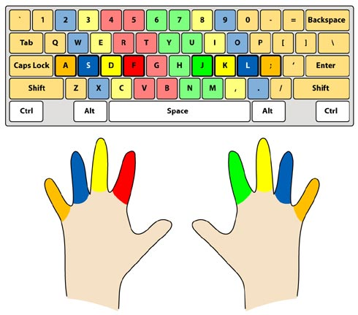
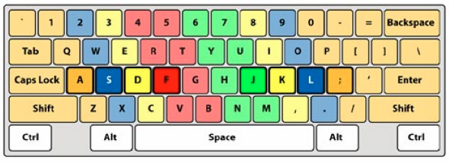
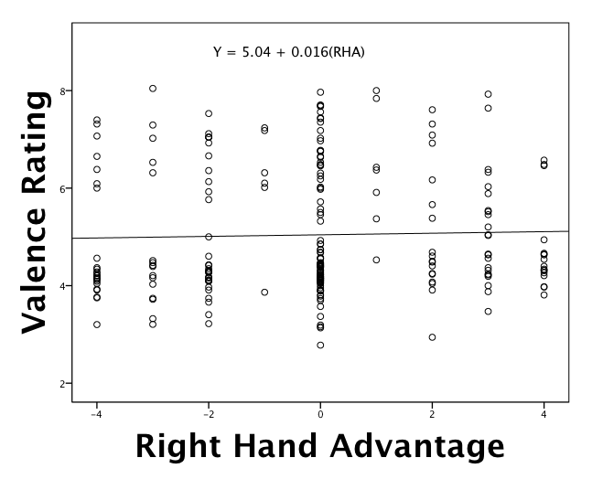
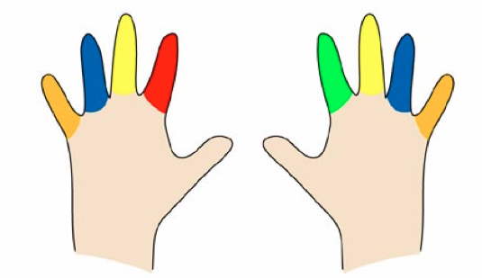
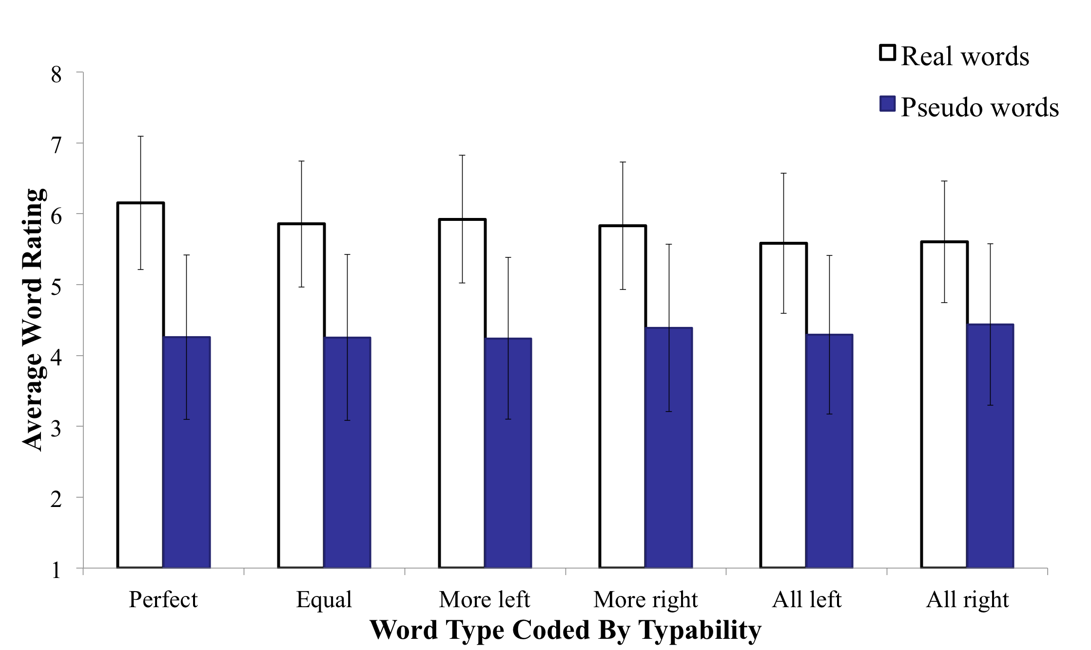
: We Like Easy Words To Type
Erin M. Buchanan, Kathrene D. Valentine, Marilee L. Teasley, Missouri State University
bstract
Recently, Jasmin and Casasanto (2012) published an article about the influence of QWERTY standard keyboards on our perception of words. They argued that the way words are typed has caused people to prefer words that have more right handed typed letters. However, we believe that the analysis of word preference is too simple. Beilock and Holt (2007) have shown that expert typists prefer letter combinations that are on opposite hands over single hands, ostensibly because they are easier to type. This research implies that both skill level and “typability” need to be considered when discussing word preference and typing. The current study replicated Jasmin and Casasanto’s study by examining preference ratings for real and fake words coded for typing sequence and controlling for typing speed of the participant.
ord oding
omparison to asmin and assanto
ypotheses
After controlling for participant typing ability, we expected to find that easier words would be rated higher than more difficult words when considering typability.
  Easy words are key press combinations that alternated hands between letters, which contain less competition for activation in the motor system.
  Therefore, perfectly alternating words should be rated higher than all other word types.
  Secondly, words with at least some alternation (equal, more right, more left: see table below) should be rated higher than words that are typed completely with the left or right hand.
We recoded our three and four letter words for “right hand advantage” wherein letters typed with the left hand were coded as a negative one and letters typed with the right hand were coded with a positive one. Right hand advantage is the total score of left and right handed coding added up.
We used right hand advantage to predict how positive participants would rate each word using simple linear regression.
As you can see in our scatterplot, there was no relationship between right hand advantage and participant pleasantness ratings, F(1, 237) < 1, p = .66.
esults
ethods
Participants
  146 undergraduate students from Missouri State University
    14 left handed, 132 right handed
  Average typing speed: 48.6 words per minute
  Average typing accuracy: 93.1%
    Participants with less than 80% accuracy were excluded.
Materials
  Real and fake words with different typing patterns
    See table below for examples
Procedure
  Participants completed a typing test, scores were recorded.
  Participants rated 120 words for pleasantness using the 9-point self-assessment manikin shown in the next column.
Main Analysis
Using a 2 (real/pseudo) X 6 (all left, all right, more left, more right, equal, perfect) repeated measures ANCOVA with a covariate of typing speed we found:
  A significant effect for real/pseudo words, F(1, 145) = 103.42, p < .001, η² = .53.
  A significant effect for word type, F(5, 460) =6.25, p < .001, η² = .06.
  A significant interaction for word type and real/pseudo words, F(5, 265) = 12.26, p < .001, η² = .12.
Interaction Post Hoc Analysis
To understand the pattern of interaction, real and pseudo words were analyzed with two different repeated measures ANCOVAs across word type controlling for typing speed.
  Pseudo words were rated equally regardless of typability, F(5, 460) = 2.06, p = .07, η² = .02
  Real words showed significant word type differences, F(5, 460) = 14.27, p < .001, η² = .13
  Fisher’s LSD and a Bonferroni corrections were used on real words and word types. Adjusted alpha was set family wise at 0.003.
eneral iscussion
After controlling for typing ability, we found the following:
  Participants do show an effect of how words are typed on their ratings of those concepts.
  For pseudo words, we found no differences in ratings for different word types. This finding shows that ratings for words we are not used to typing are not influenced by motor imagery/cognition.
  For real words, we found that ease of typing predicts how pleasant participants found words.
    The easiest words to type (perfect alternation) were rated higher than all other types of words.
    Second, equal left/right, more left and more right words were rated equally pleasant.
    Last, all left and all right words were rated equally pleasant, below the previous set.
  These findings imply that our embodied cognition of typing influences our ratings of pleasantness for concepts we are used to typing. As Beilock and Holt showed, words that are easier were rated higher than words that are more difficult to type.
Word Type | Real | Fake
Perfect Alternation (LRLR or RLRL) | Burn, Cozy, Lamb | Rorp, Mepe, Spak
Equal Amount of Left & Right (LLRR, RRLL) | Grin, Rain, Scum | Olra, Frol, Edop
More Left (LLLR, LLR) | Heal, Dirt, Rude | Jeet, Tofe, Zape
More Right (RRRL, RRL) | Lamp, Wine, Shy | Pome, Noof, Zood
All on Left (LLL, LLLL) | Cat, Vest, Safe | Zet, Tafe, Faw
All on Right (RRR, RRRR) | Milk, Nun, Mop | Hok, Poom, Joi
*
eferences
Beilock, S. L., & Holt, L. E. (2007). Embodied Preference Judgments: Can Likeability Be Driven by the Motor System?. Psychological Science, 18(1), 51-57. doi:10.1111/j.1467-9280.2007.01848.x
Jasmin, K., & Casasanto, D. (2012). The QWERTY effect: How typing shapes the meanings of words. Psychonomic Bulletin & Review, 19(3), 499-504. doi:10.3758/s13423-012-0229-7
erinbuchanan@missouristate.edu
valentine3@live.missouristate.edu
teasley888@live.missouristate.edu

